Slide 1
Thinkful Olympics

Slide 2
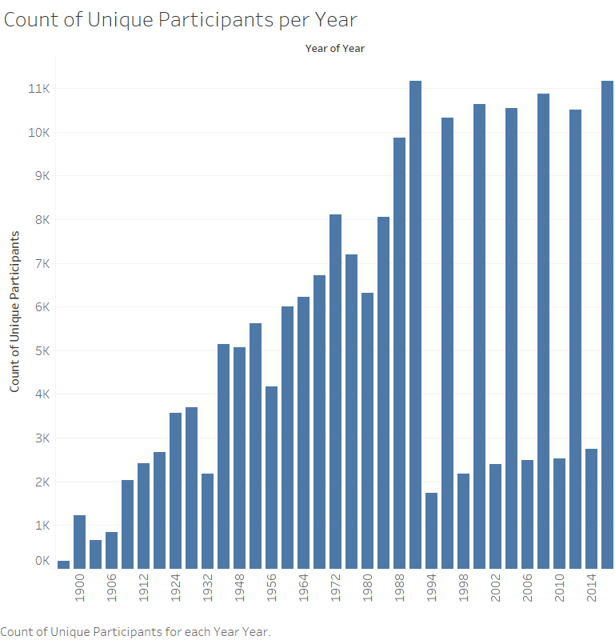

Slide 3


